Slide 1
Your ITW Dynatec Marketplace
On-demand access to your custom ITW Dynatec marketing collateral.
What you need. When you need it. Direct to you!

Slide 2
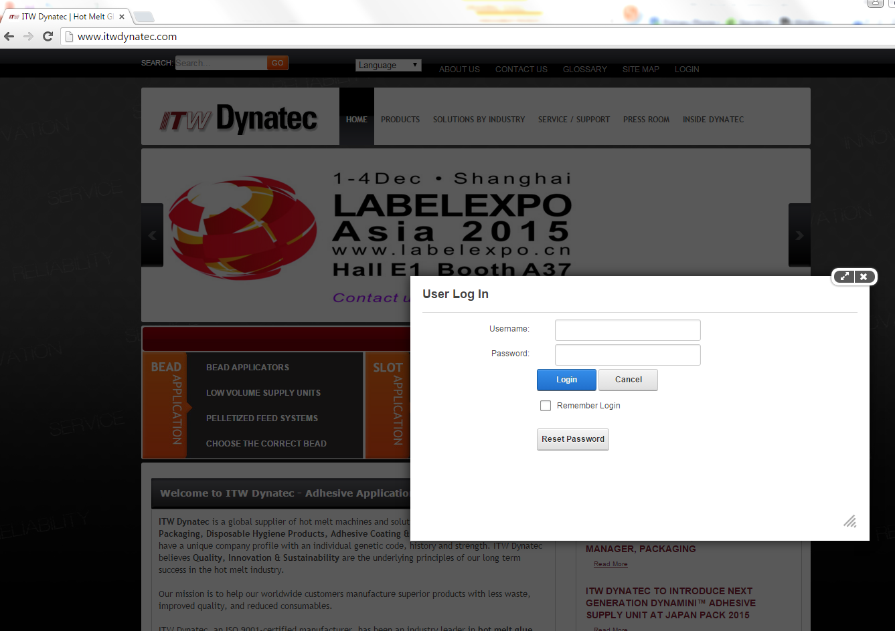
Accessing the site
Use your Dynatec username and password to login to your account on itwdynatec.com

Slide 3
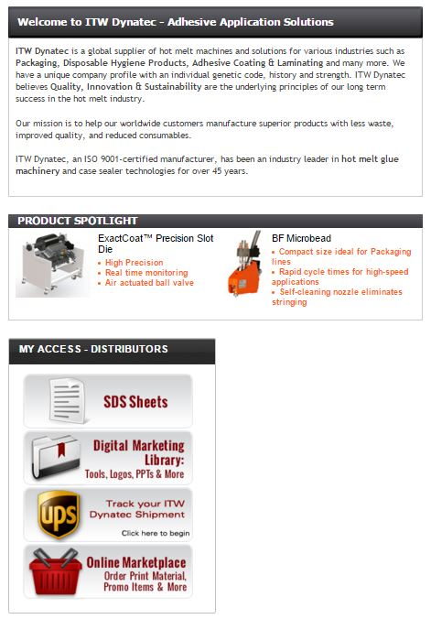
Accessing the site
Click the Online Marketplace button under your Distributor tab

Slide 4
Navigating your marketplace

Slide 5
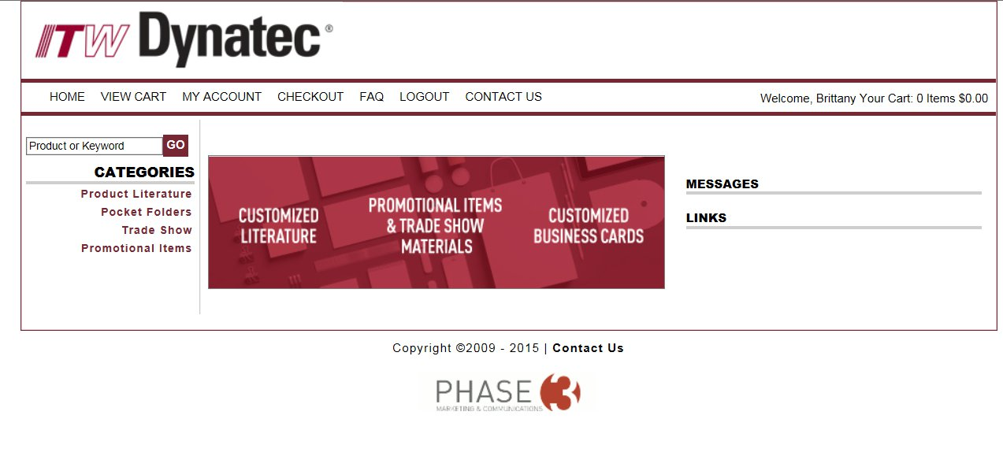
HOME PAGE

Slide 6
HOME PAGE
Welcome! From here you can access all main tabs, categories, and messages
Your top navigations will also follow you throughout the site
HOME, VIEW CART, MY ACCOUNT, CHECKOUT, FAQ, LOGOUT, CONTACT US
Categories of products are listed on the left
Messages and Links listed on the right

Slide 7
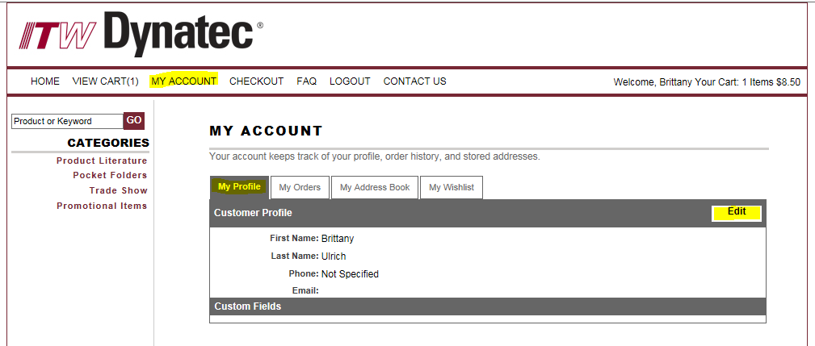
MY ACCOUNT
Update your profile information.
On your first visit to the site, please complete this step first.
Here you can also view past order history, edit/add to saved address book, and view wish lists for future orders.

Slide 8
ORDERING
Easy as 1, 2, 3!
1. Choose your items
2. Customize & Proof
3. Check out

Slide 9
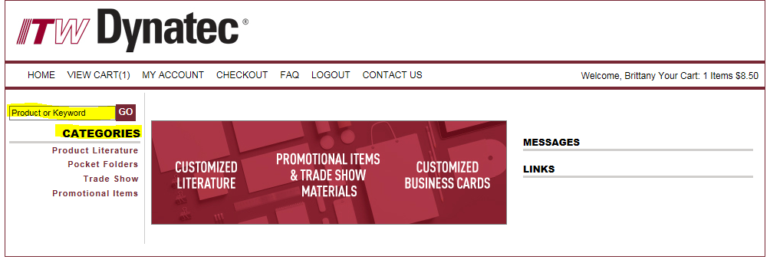
Ordering
1. Choose your item
Use the search function or search by categories to find what you need

Slide 10
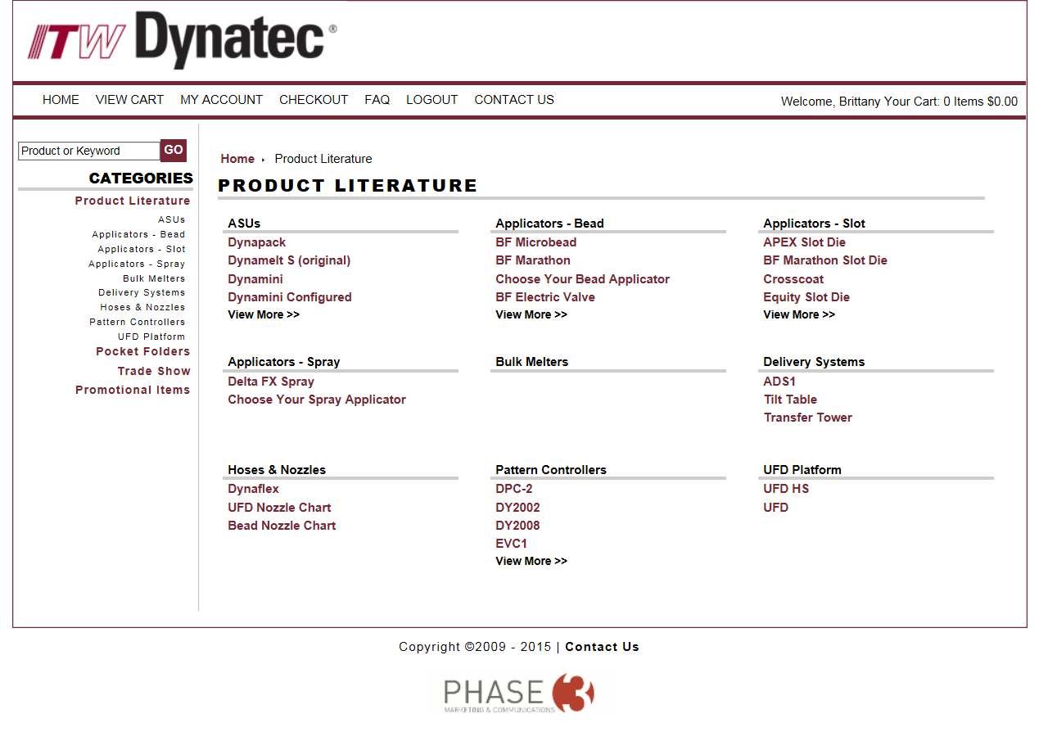
ORDERING
Categories and subcategories help narrow down the search

Slide 11
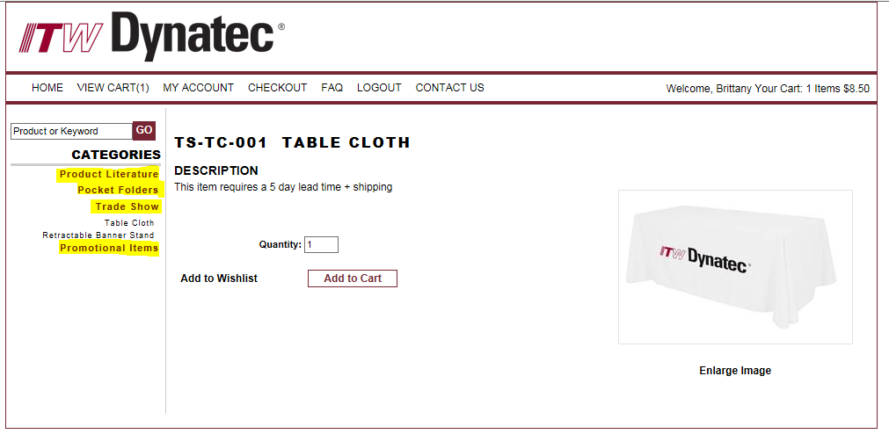
FYI : Customizable products
All Product Literature materials are customizable (if you have not submitted your company logo please do so)
Pocket folders, tradeshow materials, and promotional items are ITW Dynatec branded

Slide 12
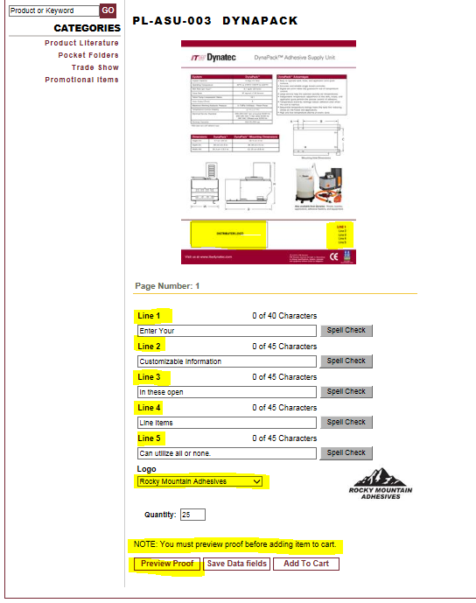
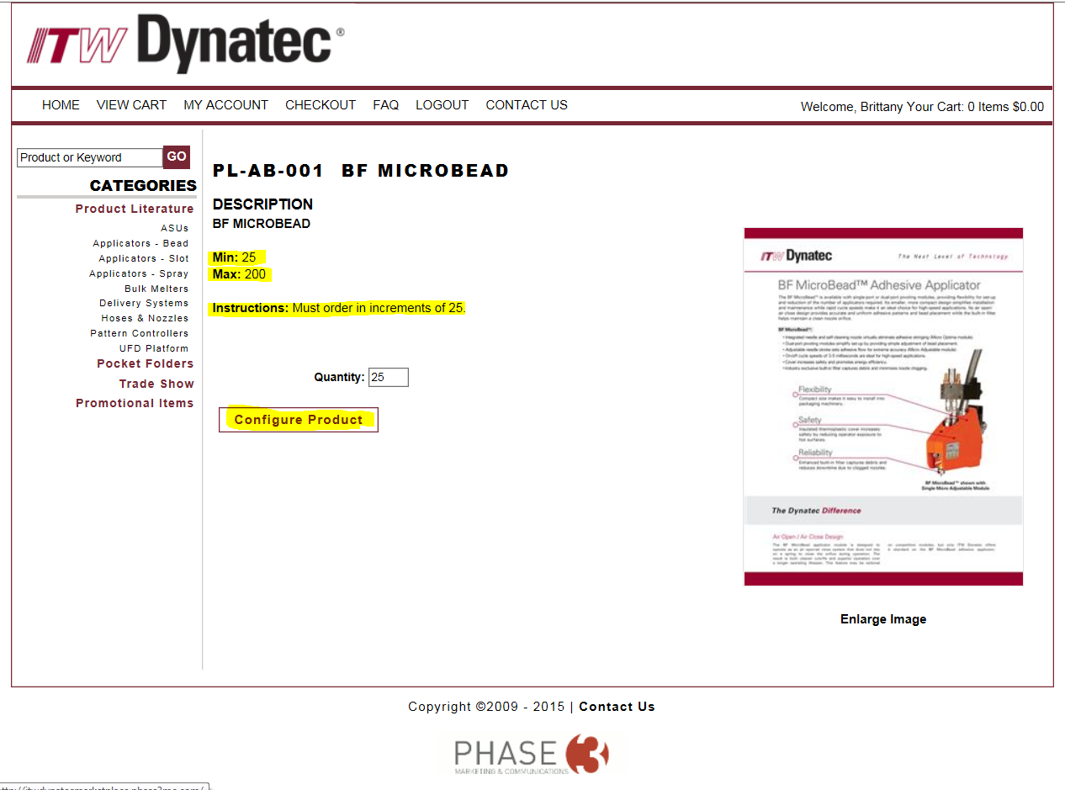
ORDERING
2. Customize & Proof
Note: Must preview proof before customizable items can be added to cart.

Slide 13
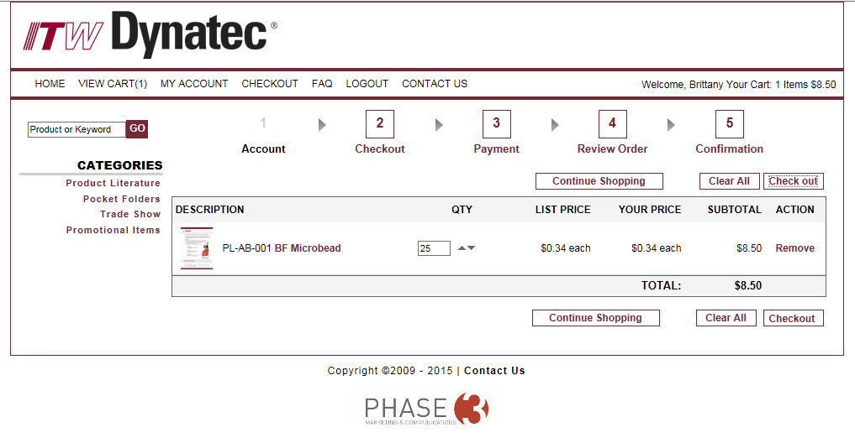
ORDERING
Once you have all your items added to your cart…
3. Checkout

Slide 14
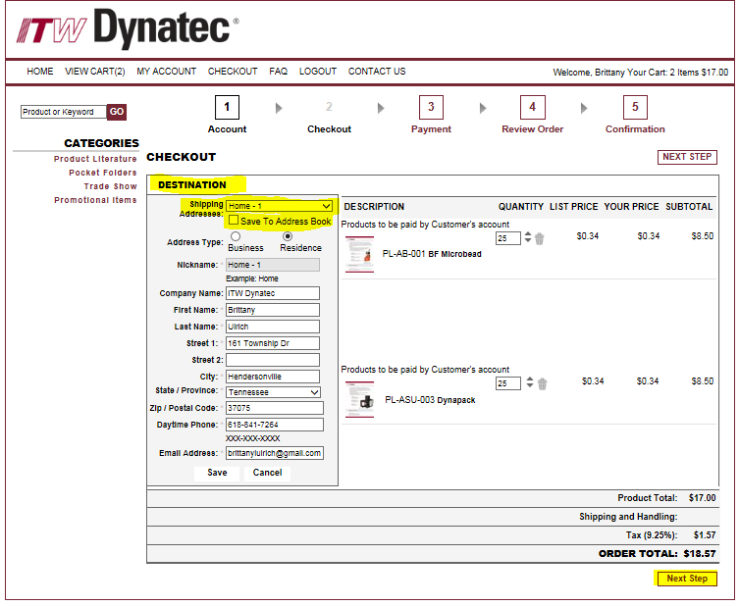
ORDERING
Add/Confirm ship to information.
- All items shipped FedEx Ground and this cost is covered on behalf of ITW Dynatec.

Slide 15
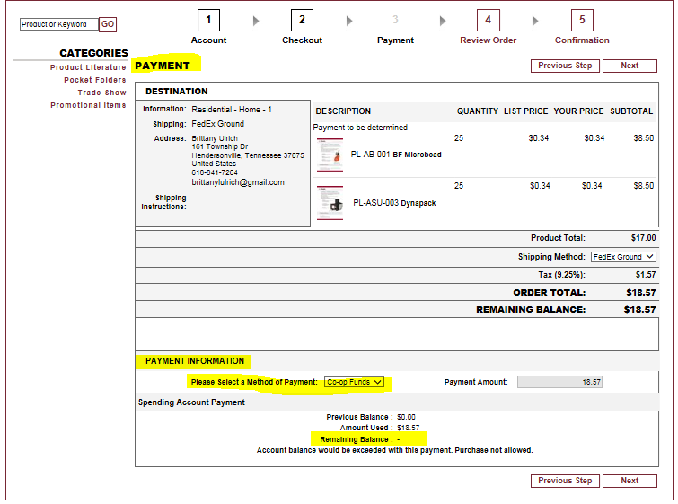
ORDERING
Choose Payment Info
Credit Card OR Co-Op Funds
Can only use (1) payment method per transaction.
Co-Op Funds expire Dec. 31st
Funds will be reset Jan 1st

Slide 16
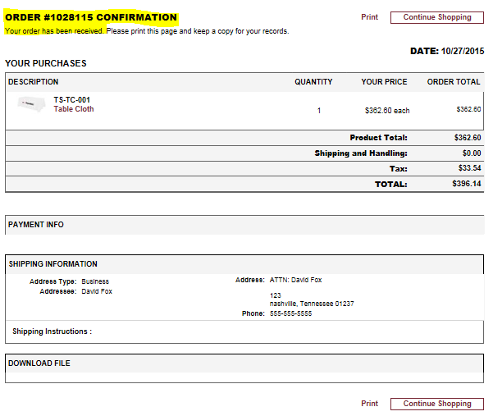
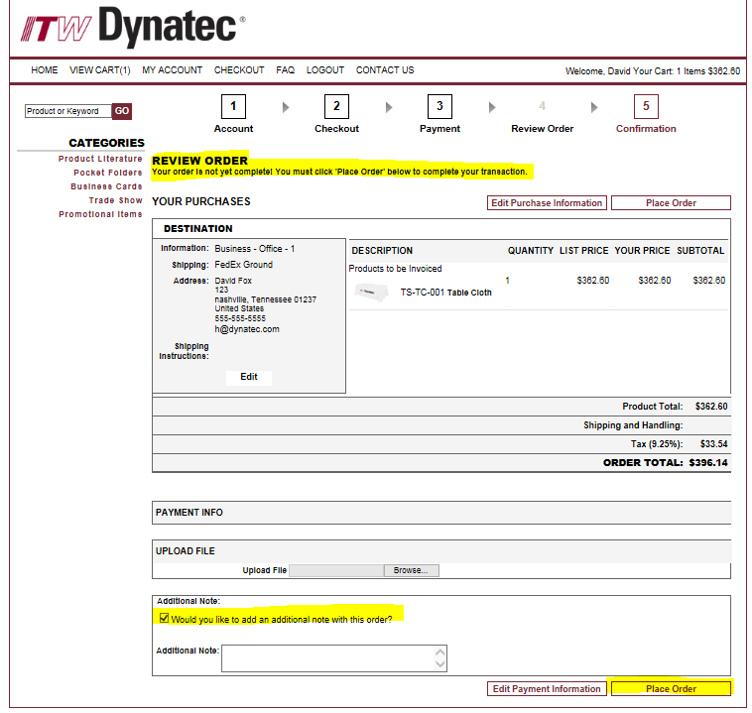
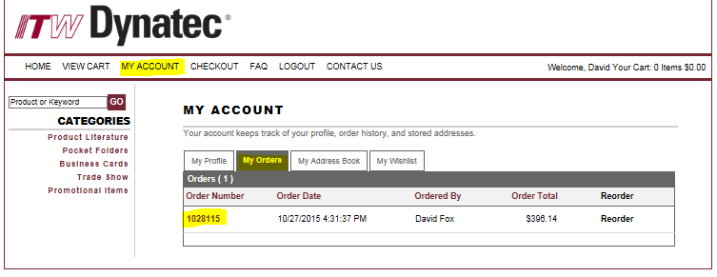
Review & Place Order
Include any special notes for your order in the Additional Info section.
Confirmation Page
This is for your records.
You can also find this info under My Account tab > My Orders

Slide 17
Additional info and resources
The FAQ page answers frequently asked questions about shipping, turn time, quantities, etc…
For questions regarding your order or navigating the site, contact Phase 3 Account Executive, Shelby Brown at shelby.brown@phase3mc.com
Check home page regularly for updated messages and links with info on new materials and ITW Dynatec news or events.

